Slide 1
Five Gr ss Z mbies
Jane Farrall

Slide 2

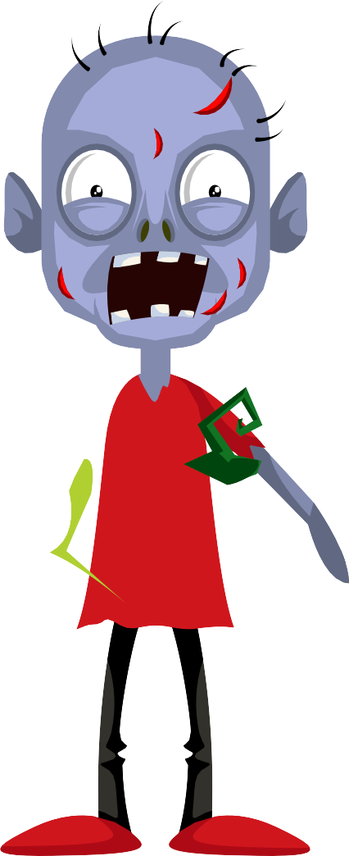
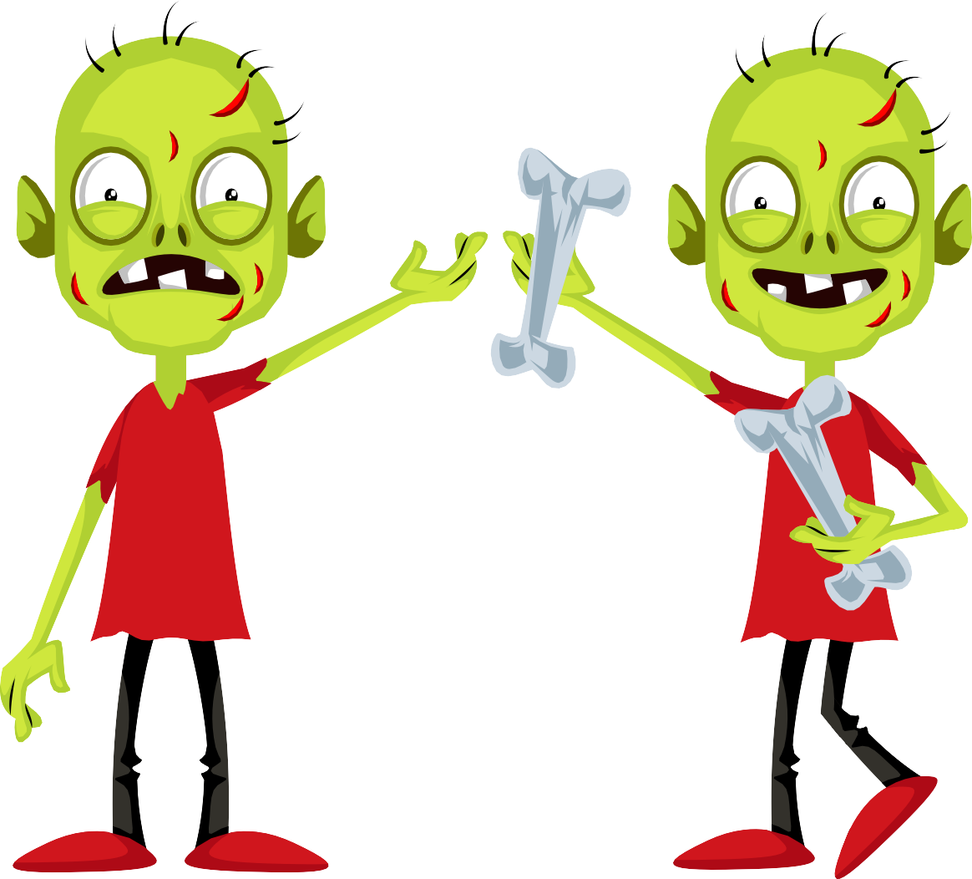
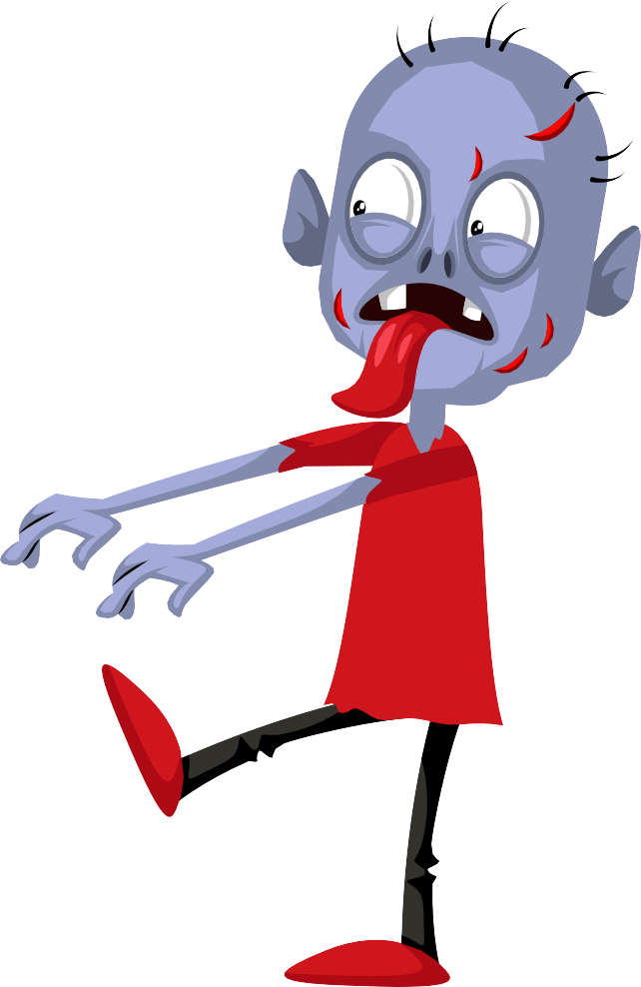



Five gross zombies went out one day, Over the crypt and far away.

Slide 3






The sun came up and they looked around, But one of the zombies couldn't be found.

Slide 4
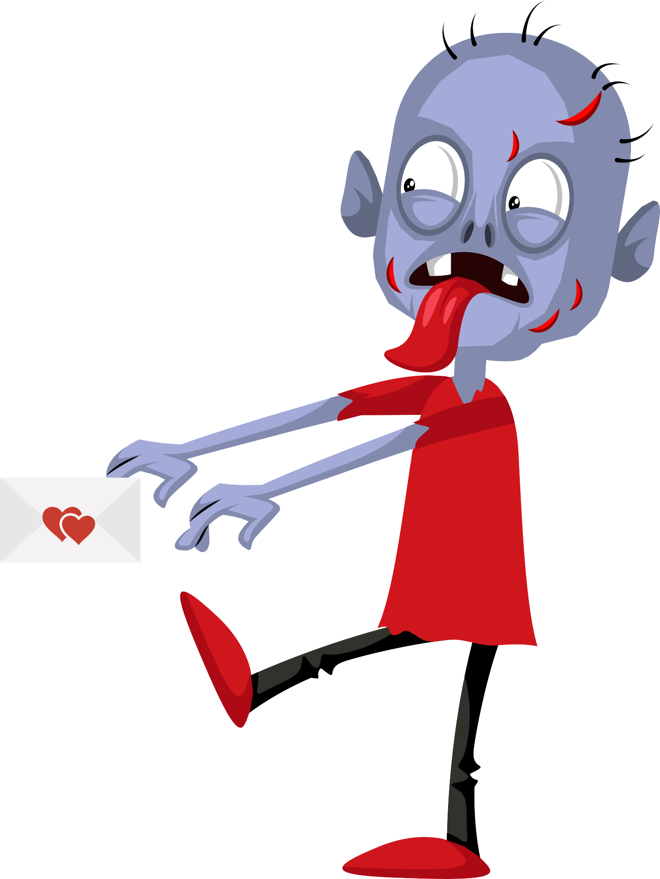

He was taking an invitation to a friend.

Slide 5






Four gross zombies went out one day, Over the crypt and far away.

Slide 6


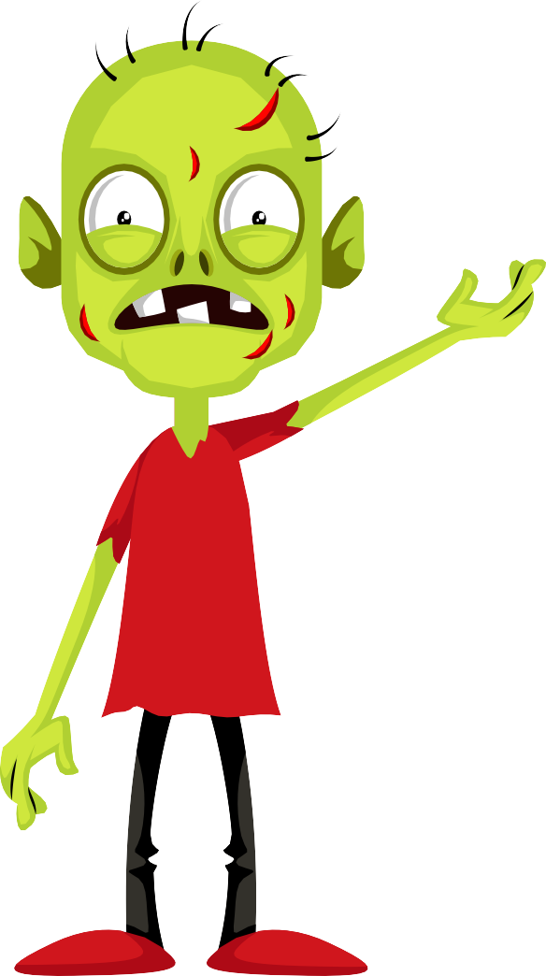



The sun came up and they looked around, But one of the zombies couldn't be found.

Slide 7
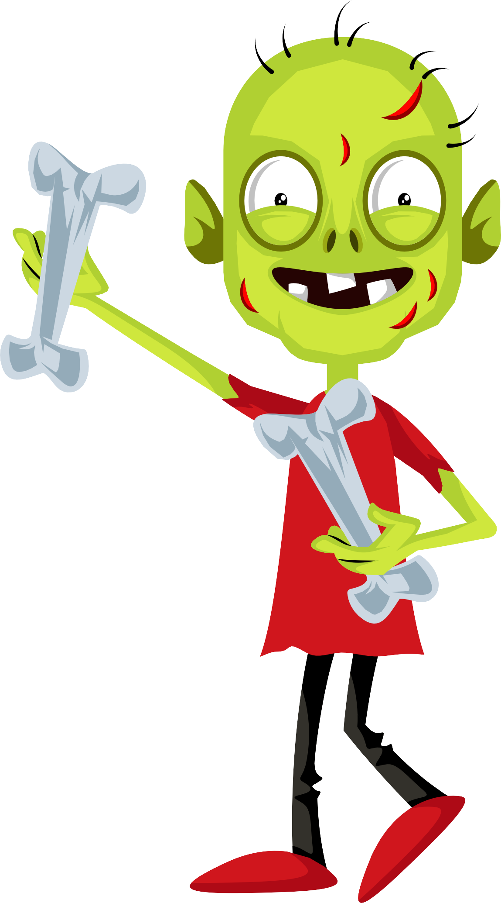

He was out buying a present.

Slide 8






Three gross zombies went out one day, Over the crypt and far away.

Slide 9




The sun came up and they looked around, But one of the zombies couldn't be found.

Slide 10
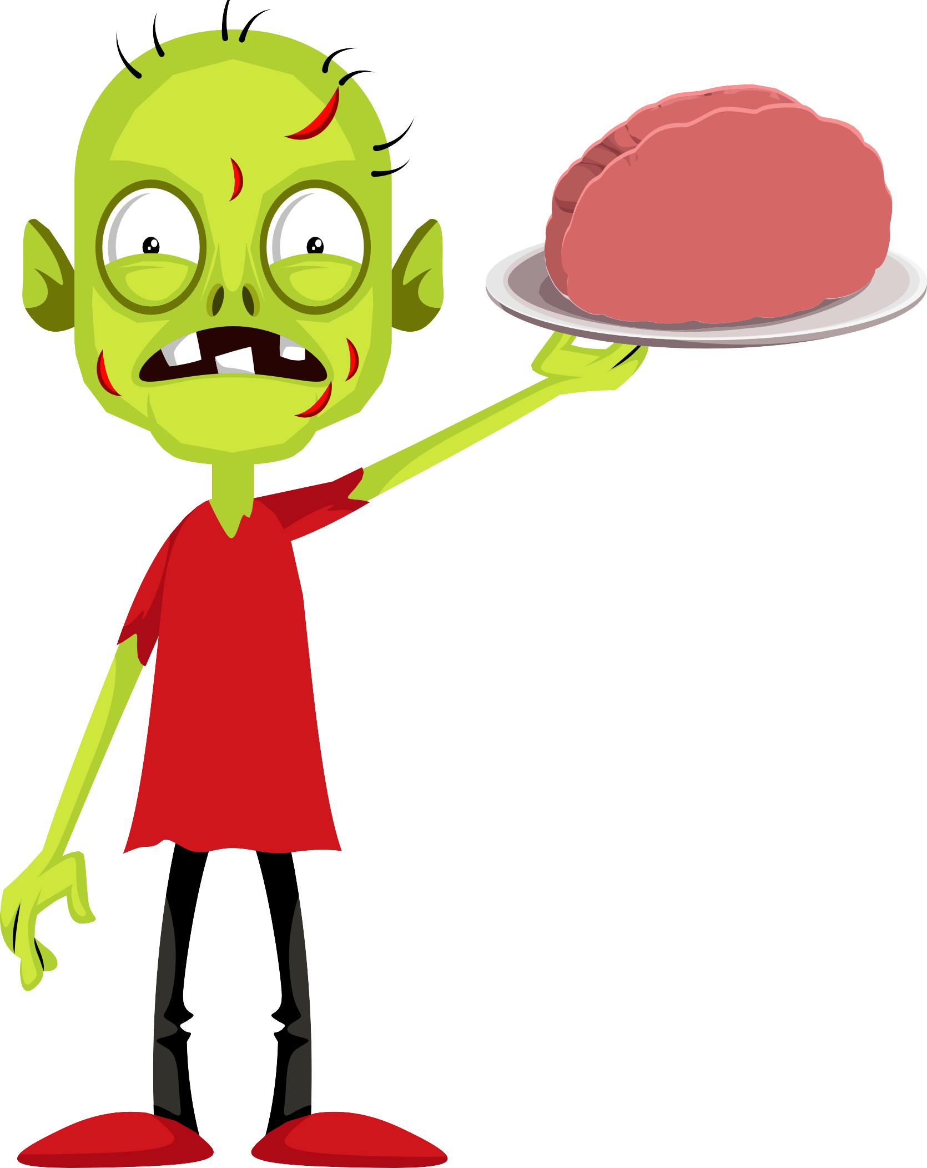
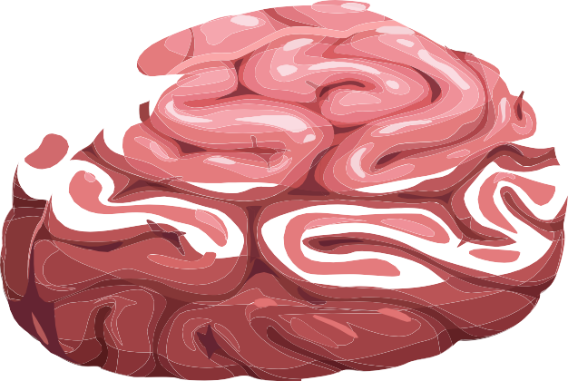
He was preparing some brains.

Slide 11





Two gross zombies went out one day, Over the crypt and far away.

Slide 12

The sun came up and he looked around, But the other zombie couldn't be found.

Slide 13




He was making some punch.

Slide 14

One gross zombie went out one day, Over the crypt and far away.

Slide 15

The sun came up and he looked around.....

Slide 16







And all the other zombies had been found. (and some extra ones too)

Slide 17


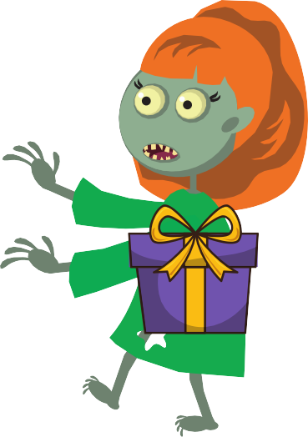

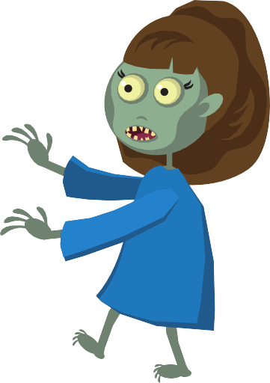

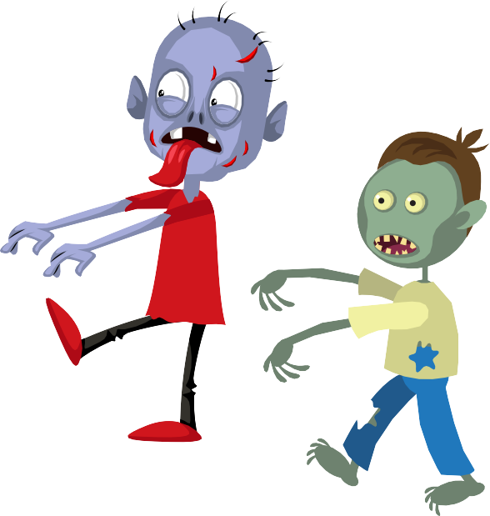



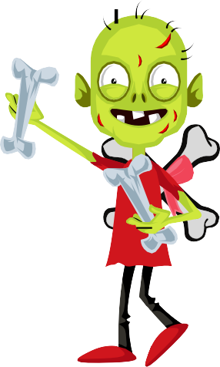


HAPPY BIRTHDAY!

