Slide 1
I DON’T LIKE FARTS
Jane Farrall

Slide 2
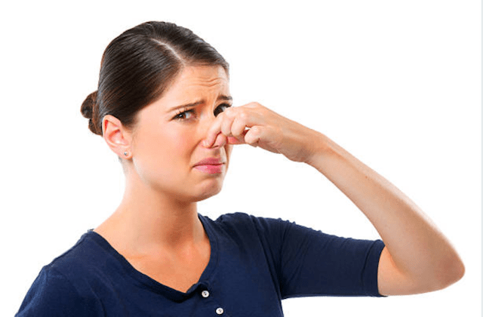
I don’t like farts.
1

Slide 3
I don’t like squeezed farts.
2

Slide 4
I don’t like gentle farts.
3

Slide 5
I don’t like quick farts.
4

Slide 6
I don’t like sustained farts.
5

Slide 7
I don’t like two-tone farts.
6

Slide 8
I don’t like wet farts.
7

Slide 9
I don’t like airy farts.
8

Slide 10
I don’t like pinched farts.
9

Slide 11
But I love fart noises!
10

Slide 12
Acknowledgements
Fart noises from Tap and Fart – Fart noise & prank soundboard machine
Video “World’s Biggest Fart – The Hippo”
Photo acknowledgements:
Cover
Slide 1
Slide 2
Slide 3
Slide 4
Slide 5
Slide 6
Slide 7
Slide 8
Slide 9

