Slide 1
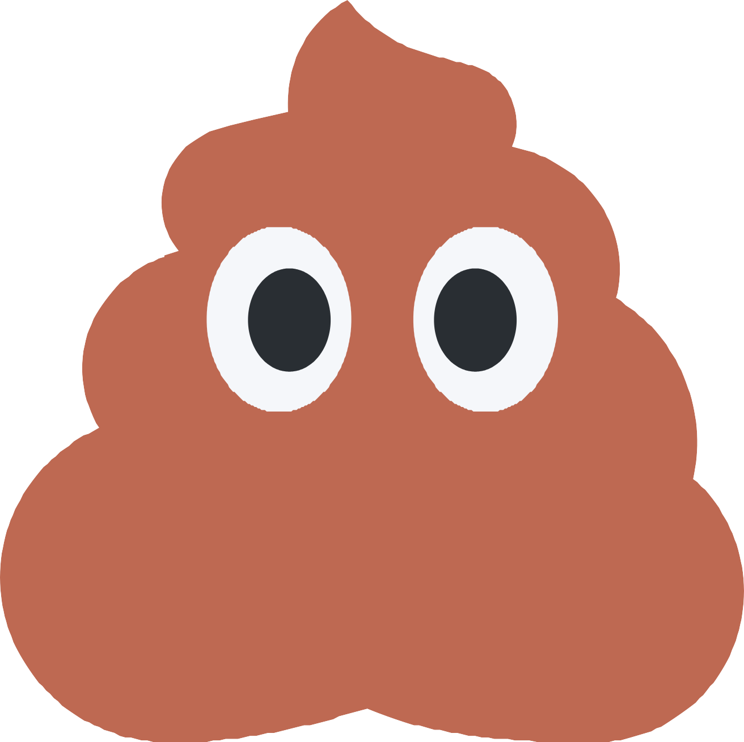
A story about things that float.....
What did I see?
Jane Farrall

Slide 2
I went to the loo, but what did I see?

Slide 3

Rabbit droppings, floating near me.

Slide 4
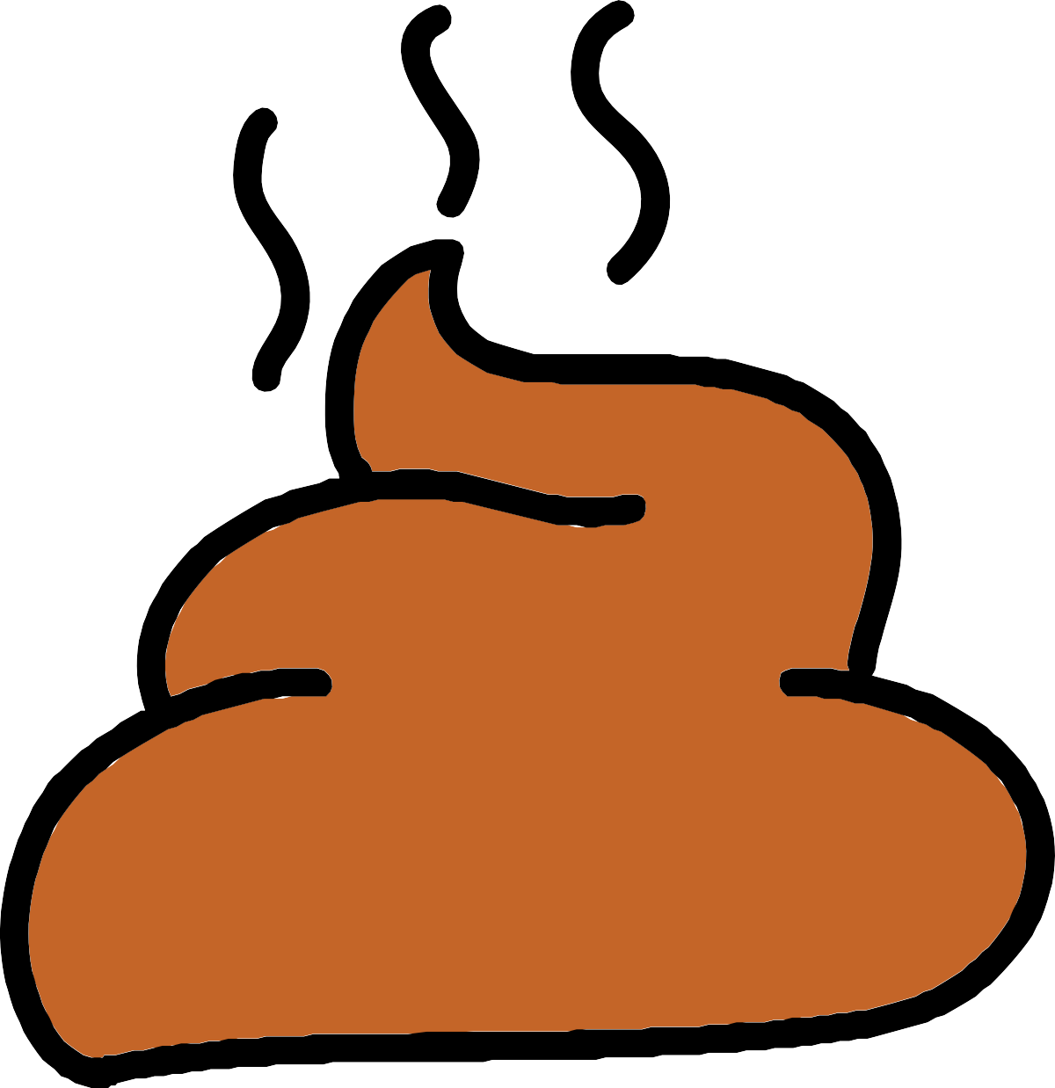
Pooo-ee!
I moved to a different cubicle.

Slide 5
I went to the loo, but what did I see?

Slide 6

A bunch of grapes, so smelly!

Slide 7
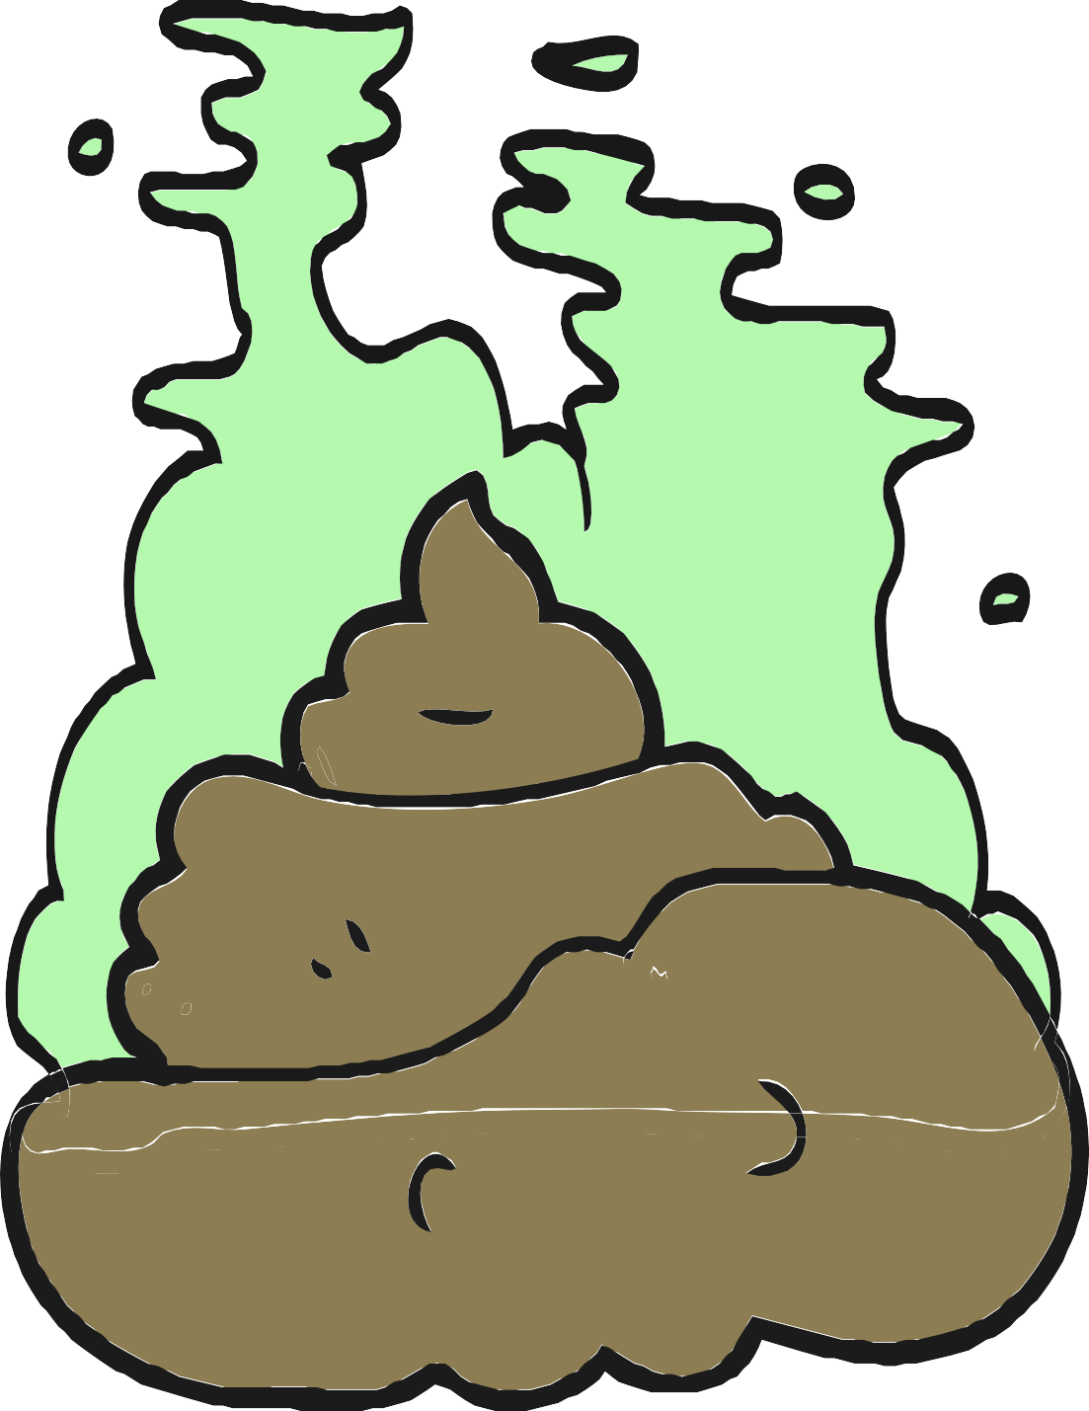
Pooo-ee!
I moved to a different cubicle.

Slide 8
I went to the loo, but what did I see?

Slide 9

Corn on the cob, I guarantee!

Slide 10
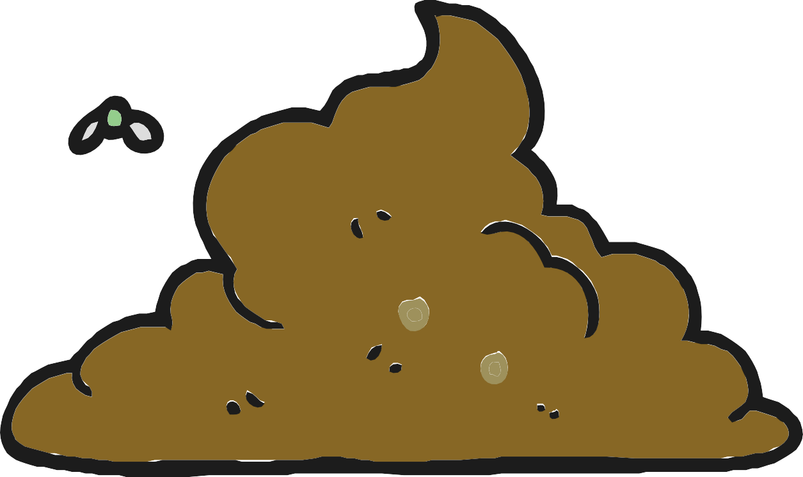
Pooo-ee!
I moved to a different cubicle.

Slide 11
I went to the loo, but what did I see?

Slide 12

Looks like a sausage, floating gently!

Slide 13




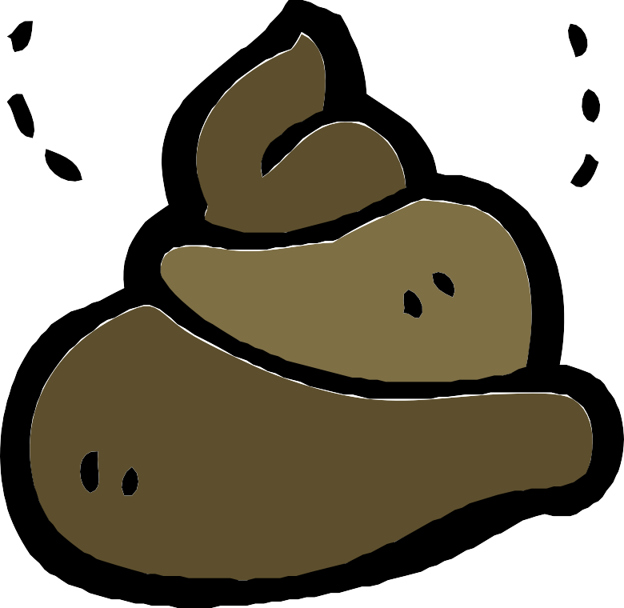
Pooo-ee!
I moved to a different cubicle.

Slide 14
I went to the loo, but what did I see?

Slide 15

Chicken nuggets, but not crunchy!

Slide 16
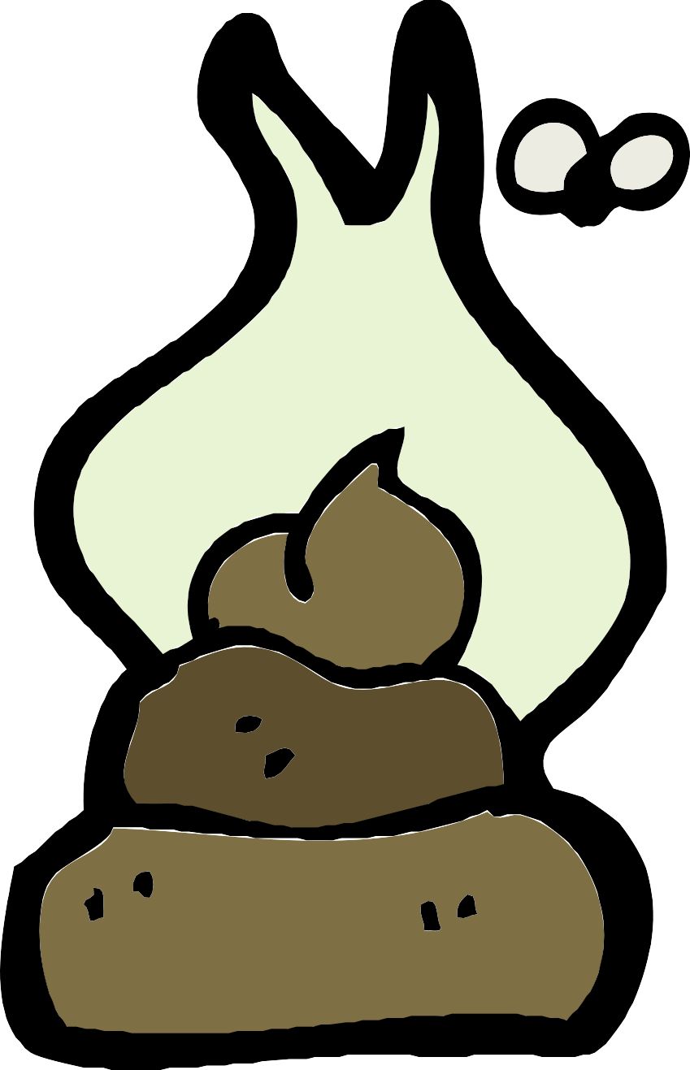
Pooo-ee!
I moved to a different cubicle.

Slide 17
I went to the loo, but what did I see?

Slide 18

Looks like porridge, to a degree.

Slide 19
Pooo-ee!
I moved to a different cubicle.

Slide 20
I went to the loo, but what did I see?

Slide 21

Looks just like gravy, so yucky!

Slide 22

Pooo-ee!
I moved to a different cubicle.

Slide 23
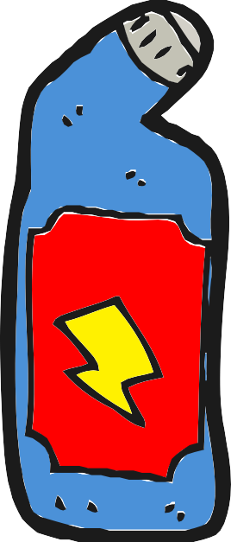
I went to the loo, it looked nice and clean.

Slide 24

I felt so happy, doing my thing.

Slide 25
Before I flushed, I looked to see,

Slide 26






What sort of poo came out of me.

Slide 27
And what do you think I saw?

Slide 28


Slide 29
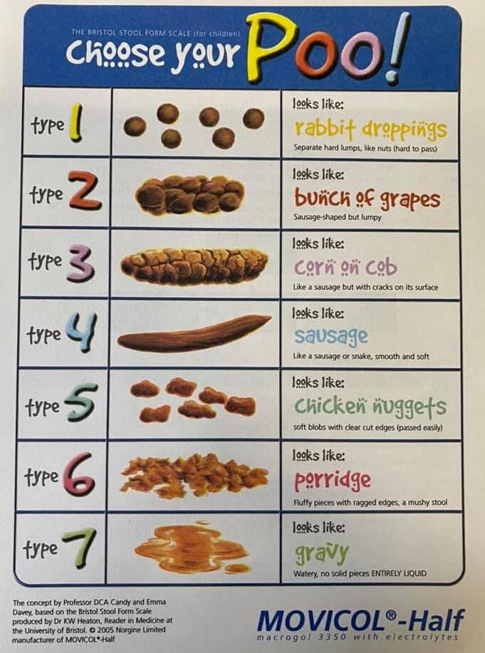
Some of the graphics in this book come from the attached information sheet, based on the Bristol Stool Scale.

